Slide 1
Basilisk Lizard-Inspired Amphibious Quadruped Robot
Hyun Soo, Steven Floyd, Nitish Thatte, Metin Sitti

Slide 2
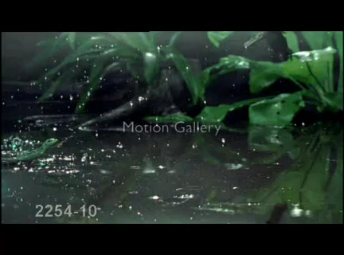
Inspiration: Basilisk Lizard

Slide 3
Air Cavity
Force generated from fluid drag
Must withdraw foot form air cavity before it collapses
Water

Slide 4
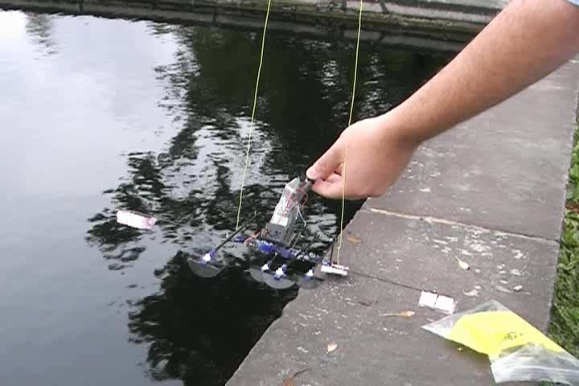
Past Prototype

Slide 5
Issues
Unstable in Roll
Needed Outriggers
Unstable in Pitch
Did not produce enough lift
Could not run efficiently on hard ground

Slide 6
Roll Motion Modeling
Assume water interaction forces exist when the robot is tilted
Assume water interaction force is linearly proportional to the footpad depth in the water
Found robot roll moment of inertia was too low for stability
Water
Lift force
depth

Slide 7

Pitch Motion Modeling
Modeling Pitch Motion
Instability due to geometry
Clockwise net moment around the center of mass
Adding an active tail can balance this moment
Level

Slide 8
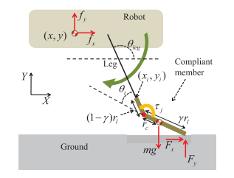
Compliant Foot Modeling
Foot Compliance enables spring-mass style running.
Compliance modeled using Pseudo rigid Body Model
Solid land running requires compliance
Water running requires stiffness
Foot optimized for compatibility with both environments

Slide 9
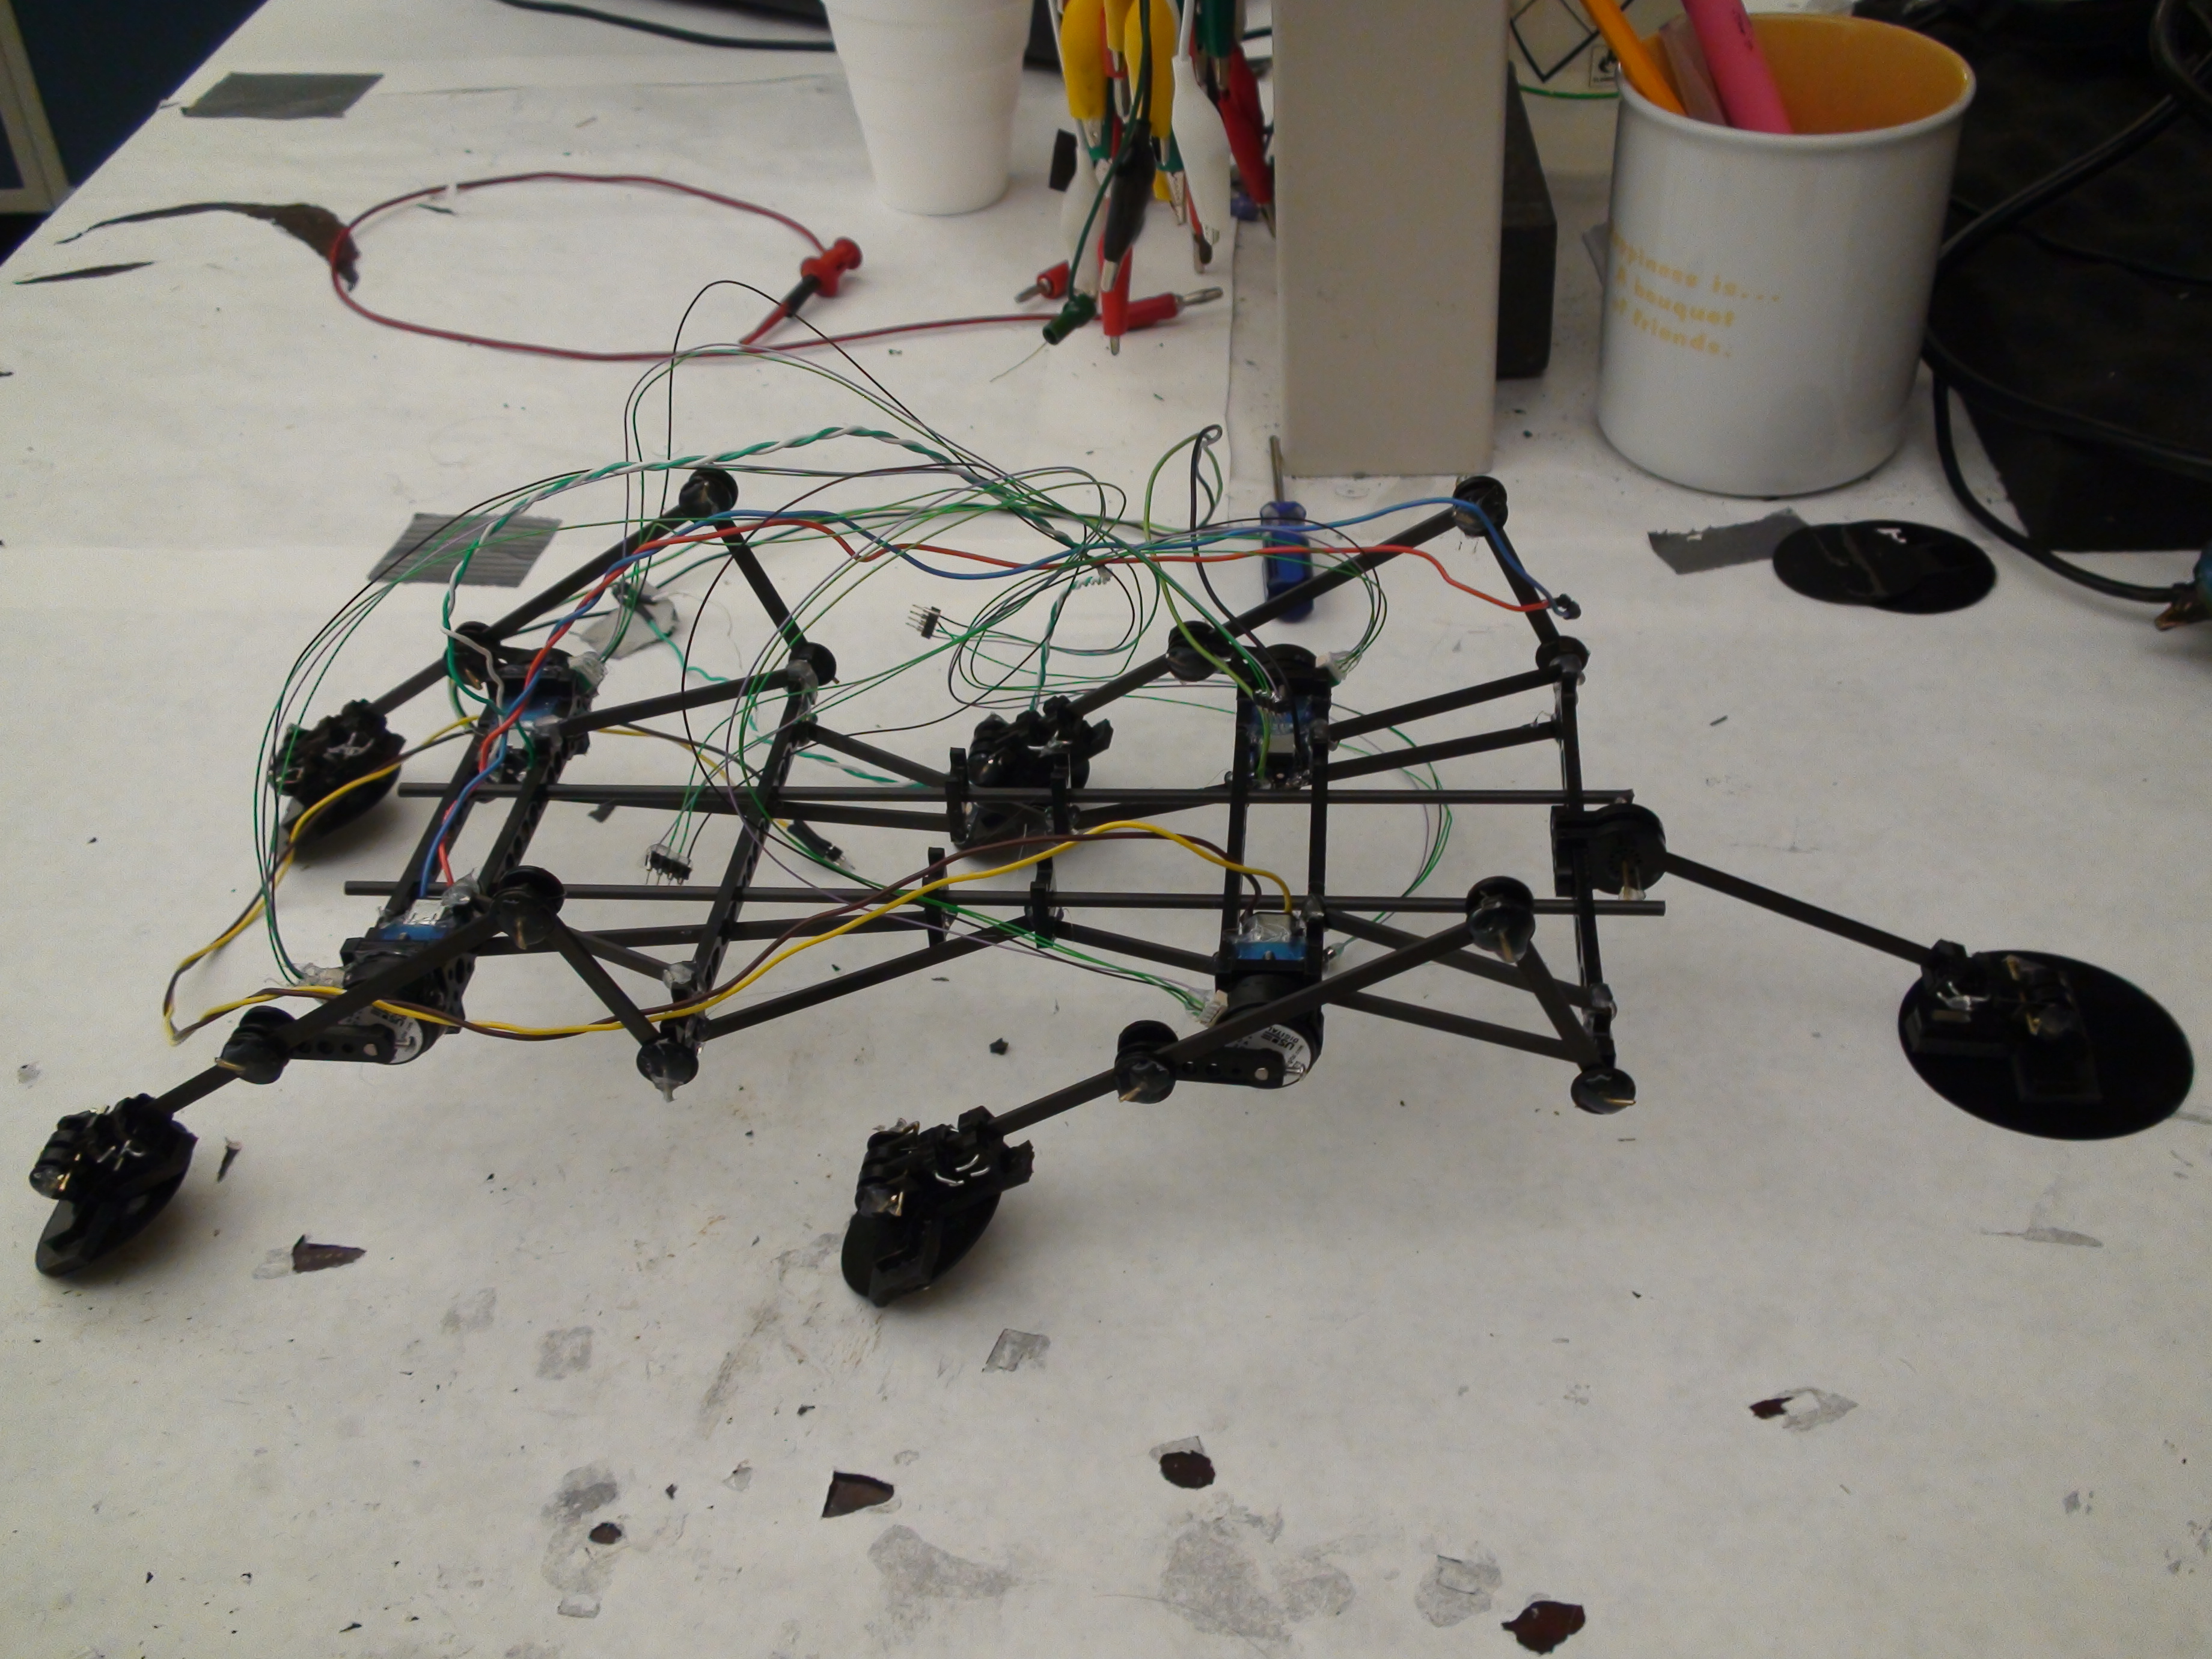
Lessons and new prototype
Much higher roll moment of inertia
Active tail for pitch stabilization
Includes magnetic compliant feet for amphibious locomotion

Slide 10
Future Work
Get robot back up and running
Implement Gait Control Loop
Simulate and optimize compliant feet for running on sand and other surfaces

